Slide 1
BIKES FOR SALE
CONTENT
Introduction
Designing
Login page
Home page
Buying page
Conclusion

Slide 2
Introduction
Welcome to my bikes for sale web page! This page is about bikes and believe that they offer a thrilling and exciting way to experience the open road.
Our web page offers a wide range of bikes for sale, including sportbikes, mountain bikes, road bikes and more.
Our mission is to provide our customers with the best possible riding experience by offering high-quality motorbikes at affordable prices.
Whether you are a beginner or an experienced rider, our bikes for sale are designed to meet your needs and preferences

Slide 3
Designing
I have designed my web page using html and css.
In html, I have use to create a web page with a structure.
In css, the page has been styled using it.
By using html and css I have created login page, home page, about, contact us and forgot password page.

Slide 4
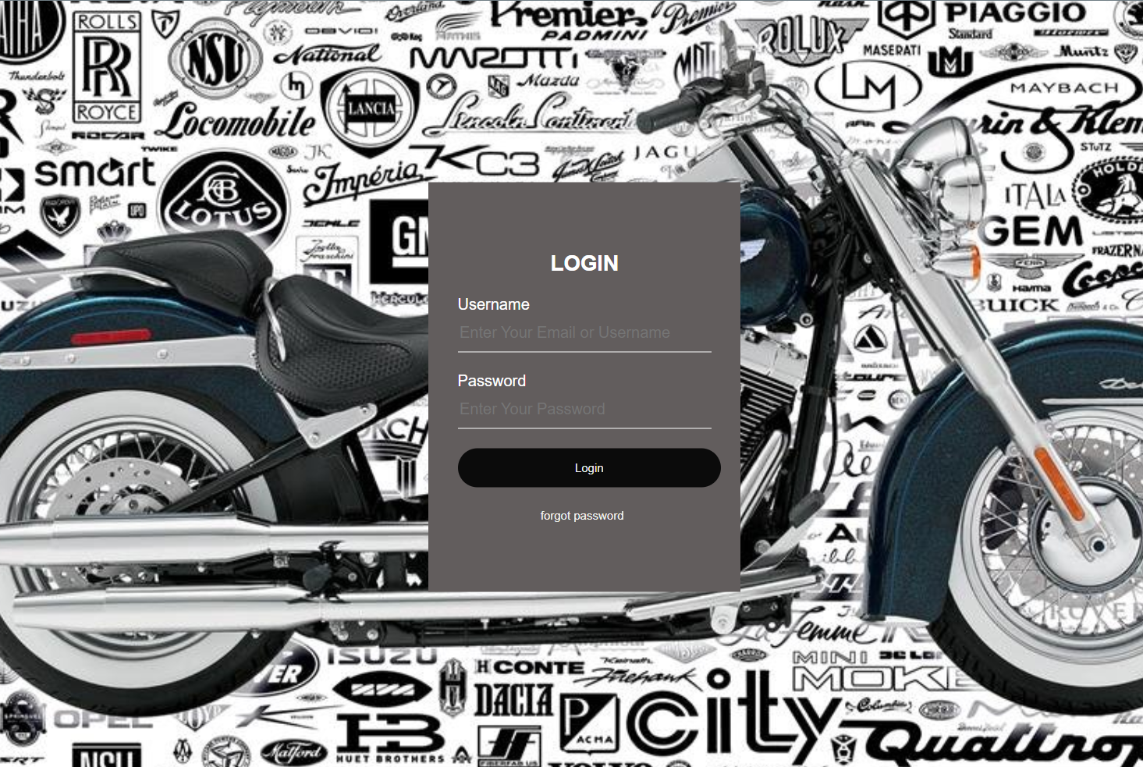
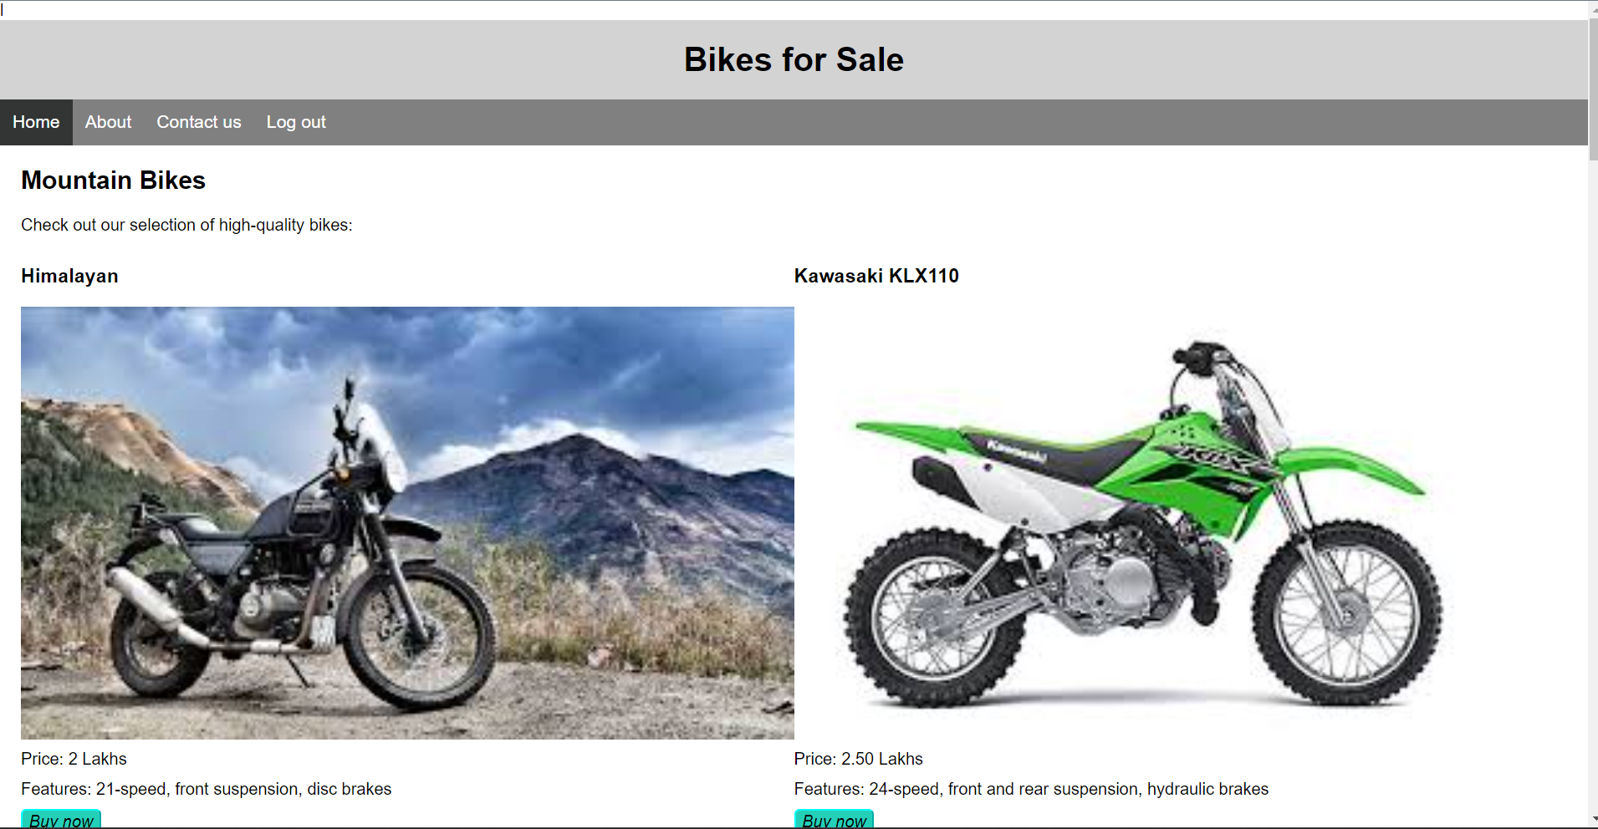
DESIGN
LOGIN PAGE
HOME PAGE

Slide 5
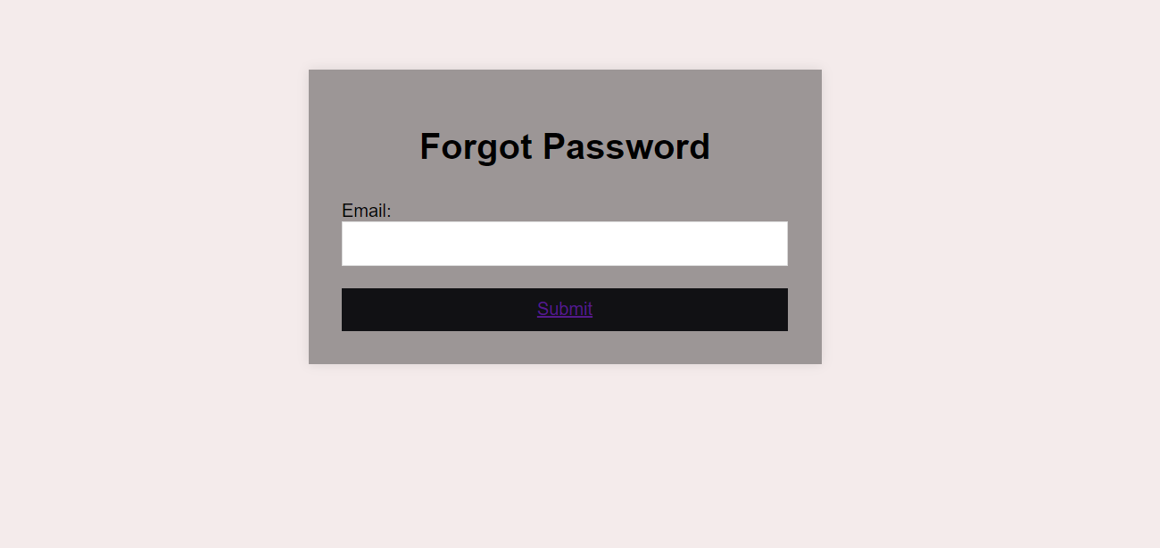
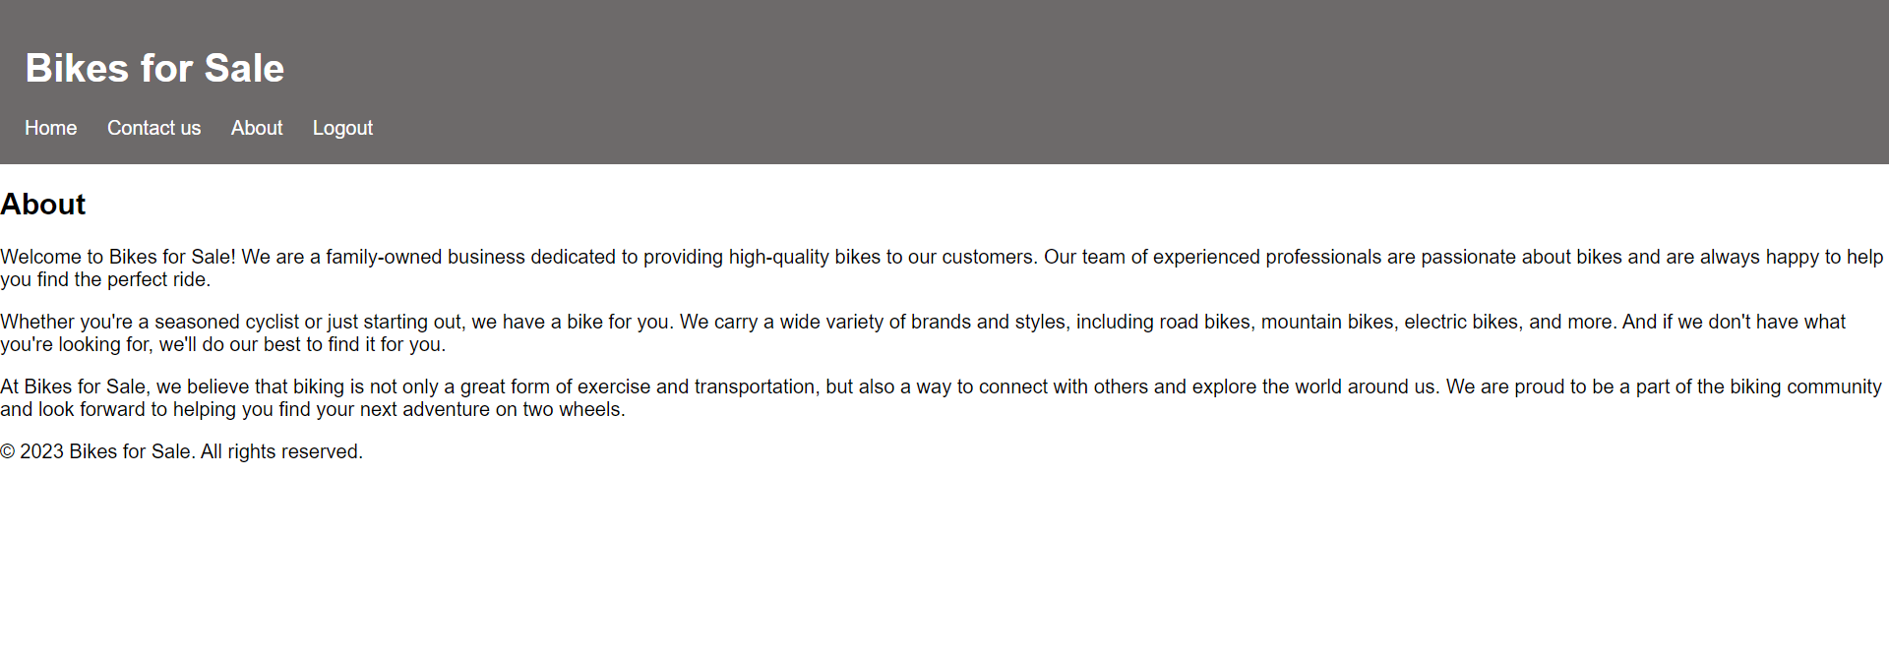
FORGOT PAGE
ABOUT PAGE

Slide 6
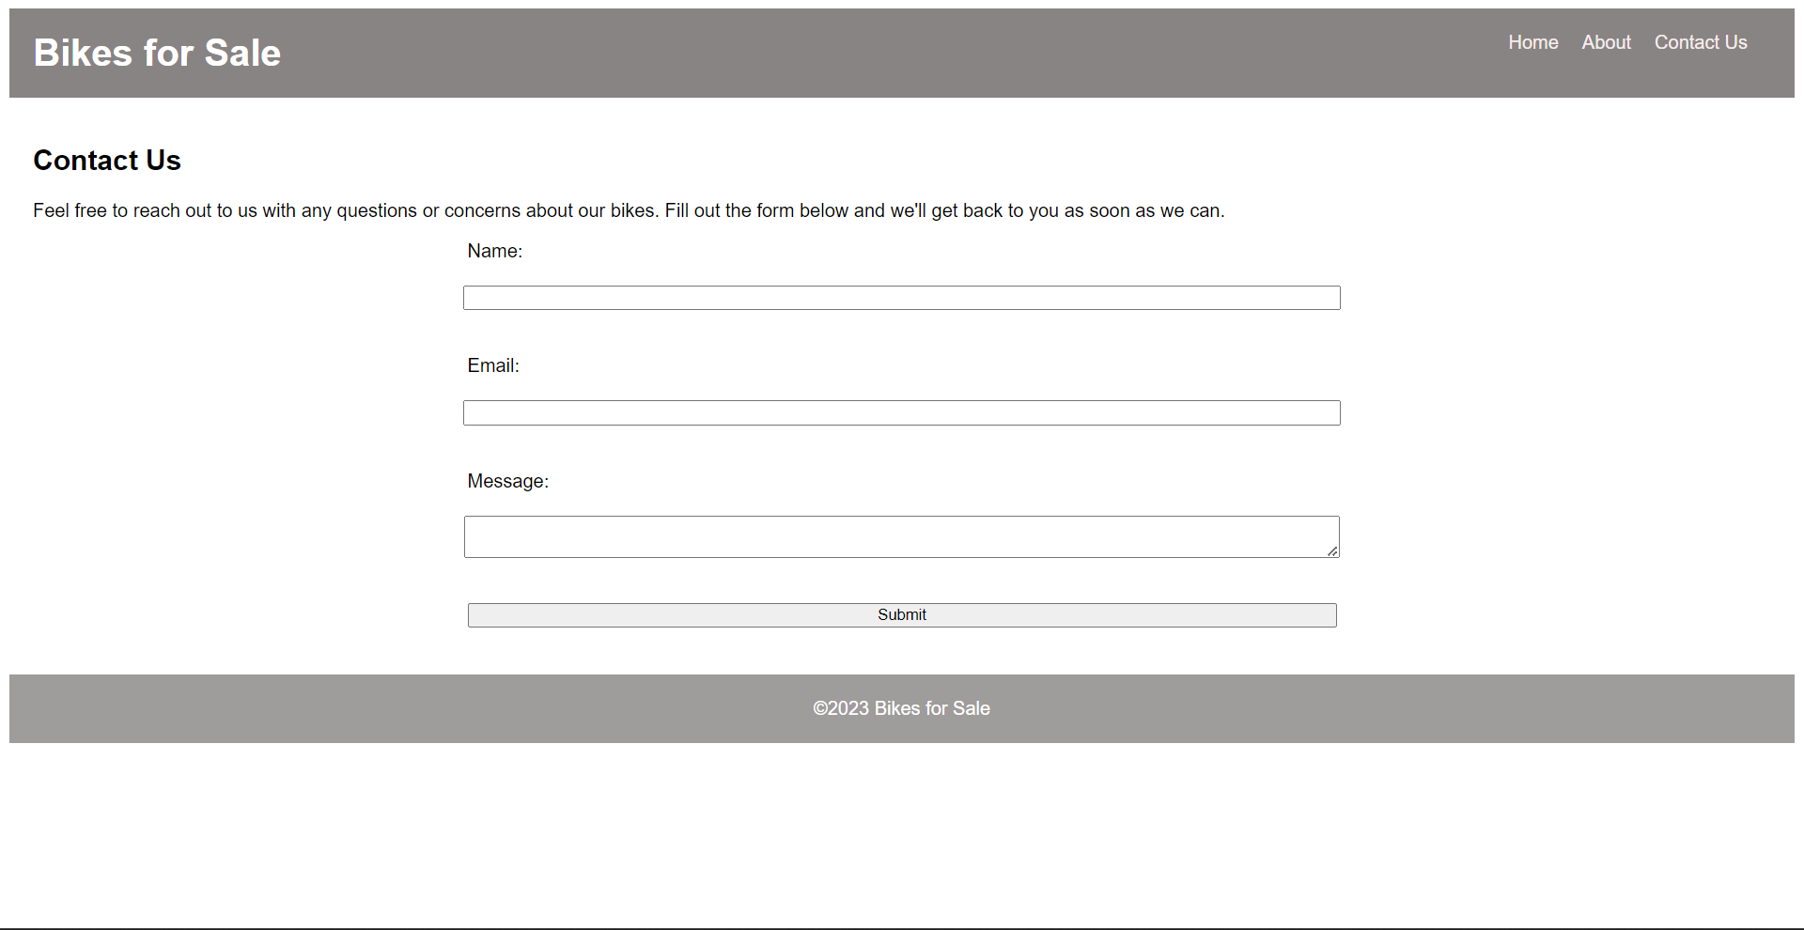
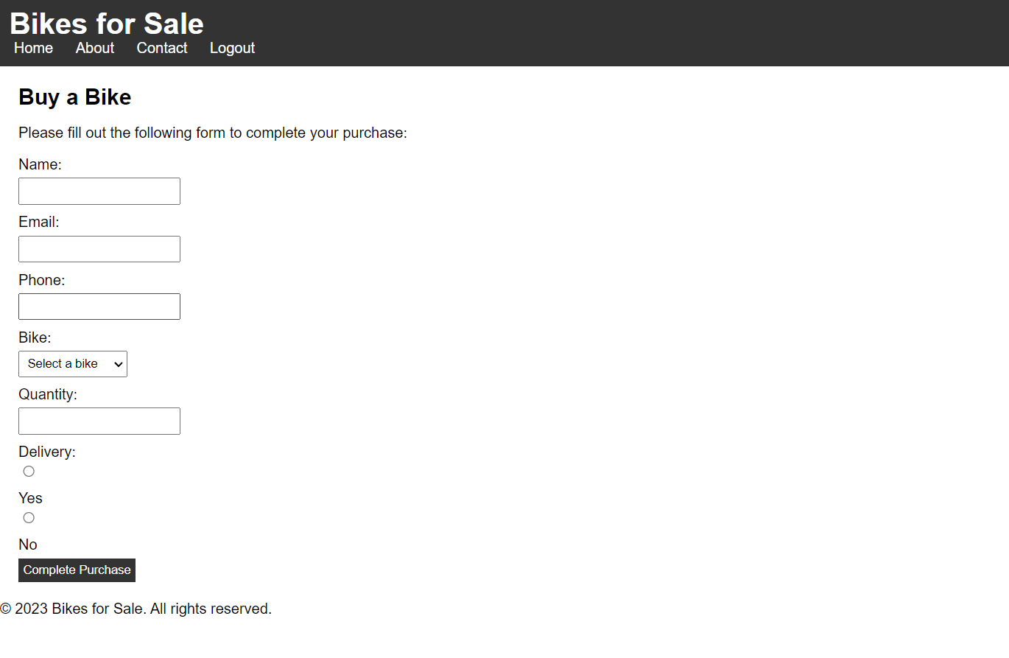
CONTACT PAGE
BUYING PAGE

Slide 7
LOGIN PAGE
It is an important aspect of the user experience.
It allows registered users to access the account securely.
It a simple , user-friendly and visually appealing.

Slide 8
HOME PAGE
It provides clear and concise information about the different types of bikes for sale.
This responsive design ensures that the content is readable and accessible on a range of devices.

Slide 9
BUYING PAGE
It provides a clear and intuitive way for users to complete their purchase by filling out the form.
It provides a bike with affordable price.

Slide 10
THANK YOU

